Slide 1
Exploratory Data Analysis
EDA

Slide 2
What is EDA ?
Exploratory Data Analysis(EDA) is an approach to analyzing data set to summarize their main characteristics , often with visual methods.
Every machine learning problem solving starts with EDA.
It is probably the most important part of a machine learning project.

Slide 3
Why do we use EDA?
Checking for Assumption.
Preliminary Selection of appropriate model.
Determining relationship among explanatory variables.
Determining the direction and rough size of relationship between explanatory variable and outcome variable.

Slide 4








How to perform EDA?
EDA can be performed by using Business Intelligence(BI) tool like Tableau, Power BI, IBM Cognos, Qlik sense and other tools.
EDA can also be performed in R and python by using packages/libraries like matplotlib, seaborn, plotly etc.

Slide 5
Methods Used for EDA:
Univariate visualization - This method is performed to provides summary statistics for each field in the data set.
Bivariate visualization - This method is performed to find the relationship between each variable in the dataset and the target variable of interest.
Multivariate visualization - This method is performed to understand interactions between different fields in the dataset.

Slide 6
Univariate Plots
Different Types of Plots.
Dot plot
Pie Chart
Box plot
Histogram
Distribution plot
Violin Plot
KDE Plot

Slide 7
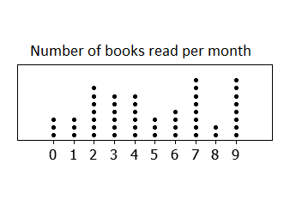
Dot Plot
Dot plot is a statistical chart consisting of data points plotted on a fairly simple scale, typically using filled in circles.

Slide 8
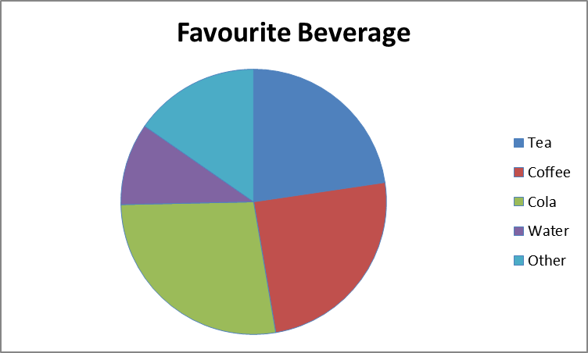
Pie chart
Pie Chart is a special chart that uses "pie slices" to show relative sizes of data. The chart is divided into sectors, where each sector shows the relative size of each value.

Slide 9
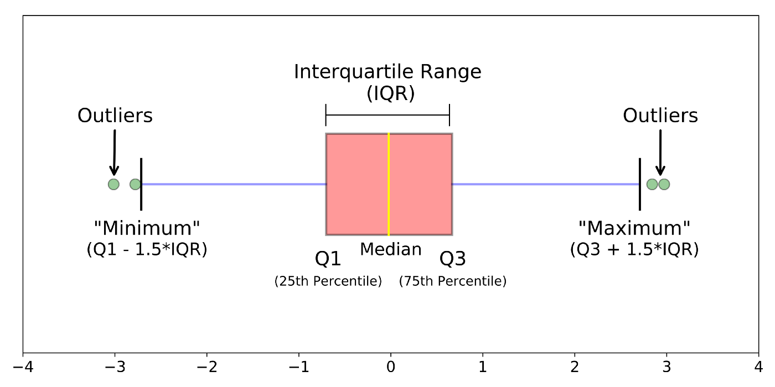
Boxplot
A box plot shows the five-number summary of the data – the minimum, first quartile, median, third quartile, and maximum.
Box plot is also used for detection of outliers in data set.

Slide 10
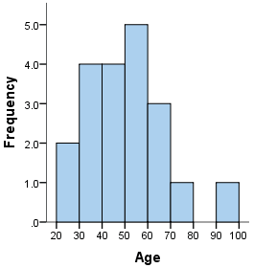
Histogram
A histogram is a plot that lets you discover, and show, the underlying frequency distribution of a set of continuous data.

Slide 11
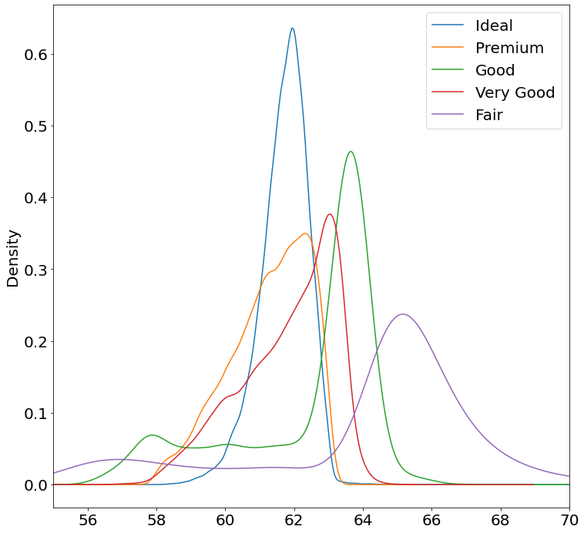
Distribution plot
Distribution plot is used to determine the probabilities of specific data values within the distribution.

Slide 12
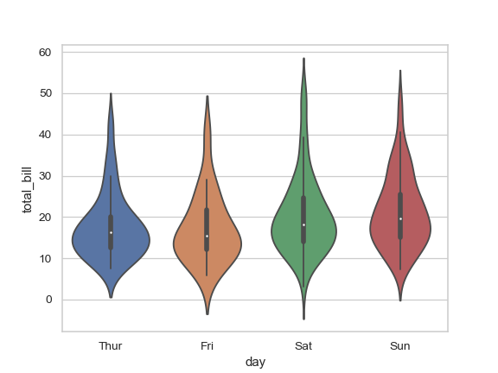
Violin plot
Violin plots are a method of plotting numeric data and can be considered a combination of the box plot and density plot.

Slide 13
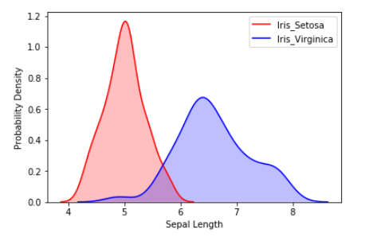
KDE Plot
KDE Plot also known as Kernel Density Estimate is used for visualizing the Probability Density of a continuous variable.

Slide 14
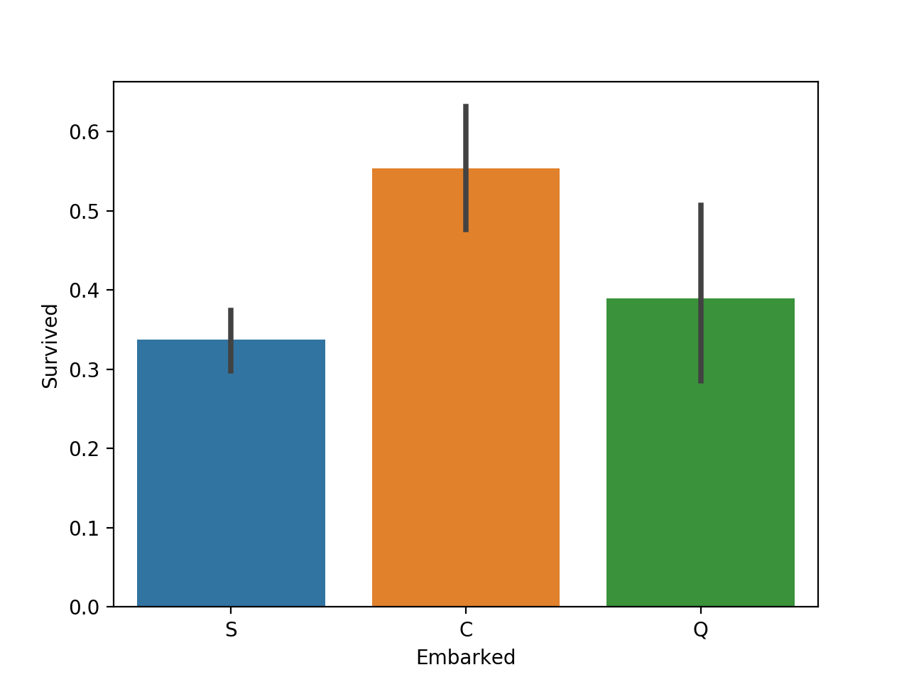
Bivariate Plots
Bar plot
A bar graph is a chart that uses bars to show comparisons between categories of data. A bar graph will have two axes. One axis will describe the types of categories being compared, and the other axis will show the numerical values. The bars can be either horizontal or vertical.

Slide 15
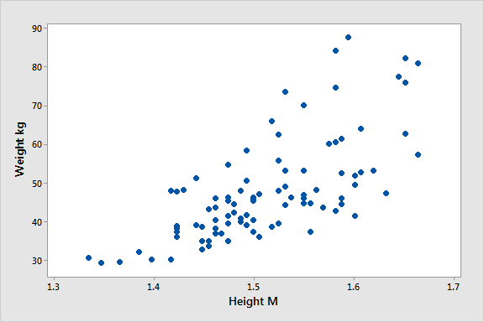
Scatter Plot
A scatter plot is a set of points plotted on a horizontal and vertical axes. If no correlation exists between the variables, the points appear randomly scattered on the coordinate plane. If a large correlation exists, the points concentrate near a straight line

Slide 16
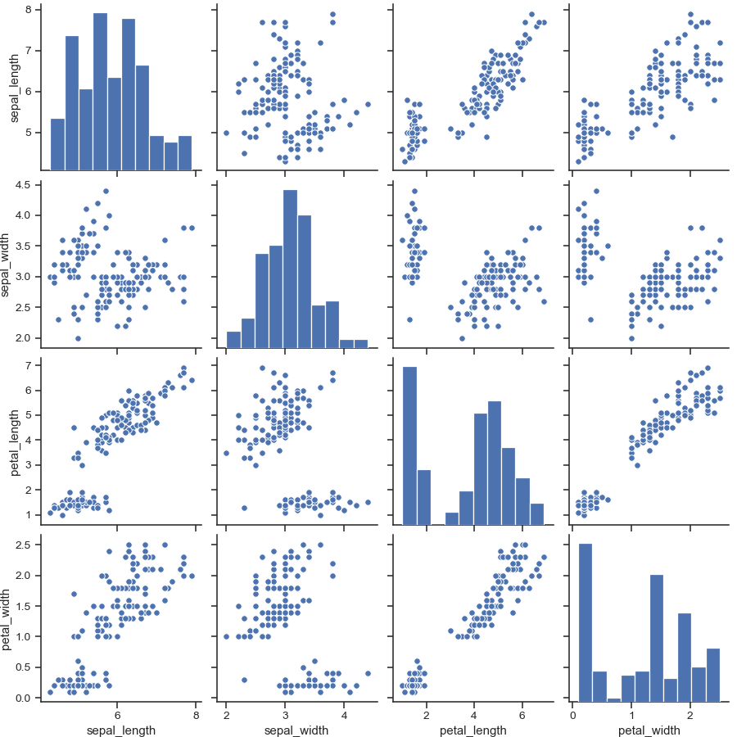
Multivariate Plots
Multivariate plots are designed to reveal the relationship among several variables simultaneously.
Pair Plot

Slide 17
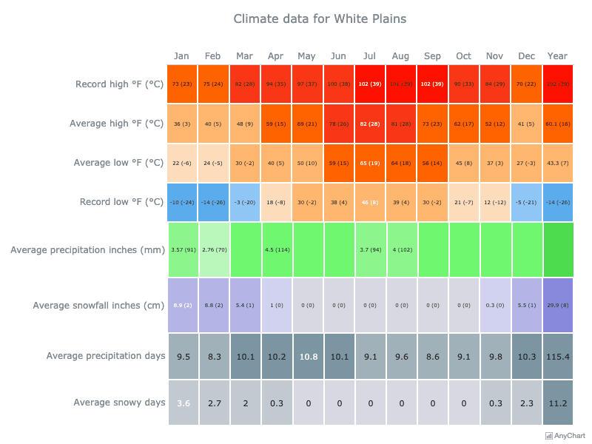
Heat Map
A heat map is a data visualization technique that shows magnitude of a phenomenon as color in two dimensions.

Slide 18
Feature Engineering
Feature engineering is the process of using domain knowledge to extract features from raw data .
These features can be used to improve the performance of machine learning algorithms.

Slide 19
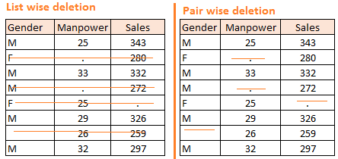
Methods to treat missing values
Deletion: It is of two types: List Wise Deletion and Pair Wise Deletion.
In list wise deletion, we delete observations where any of the variable is missing. This method reduces the power of model because it reduces the sample size.
In pair wise deletion, we perform analysis with all cases in which the variables of interest are present. Advantage: It keeps as many cases available for analysis. Disadvantage: It uses different sample size for different variables.

Slide 20
Mean/ Mode/ Median Imputation
This method consists of replacing the missing data for a given attribute by the mean or median (quantitative attribute) or mode (qualitative attribute) of all known values of that variable.
Strategies
○ Mean: Basic approach.
○ Median: When we have outliers in dataset.
○ Mode: Most frequent value.

Slide 21
Prediction Model
Prediction model is one of the advance method for handling missing data. Here, we create a predictive model to estimate values that will substitute the missing data.
In this case, we divide our data set into two sets: One set with no missing values for the variable and another one with missing values.
First data set become training data set of the model while second data set with missing values is test data set and variable with missing values is treated as target variable.
Next, we create a model to predict target variable based on other attributes of the training data set and populate missing values of test data set.
We can use regression, ANOVA, Logistic regression and various modeling technique to perform this.
Drawbacks : If there are no relationships with attributes in the data set and the attribute with missing values, then the model will not be precise for estimating missing values.

Slide 22
KNN Imputation
In this method of imputation, the missing values of an feature are imputed using the given number of feature that are most similar to the feature whose values are missing. The similarity of two features is determined using a distance function.
Advantages:
k-nearest neighbour can predict both categorical & numerical features.
Attributes with multiple missing values can be easily treated
Correlation structure of the data is taken into consideration
Disadvantage:
Choice of k-value is very critical. Higher value of k would include features which are significantly different from what we need whereas lower value of k implies missing out of significant attributes.

Slide 23
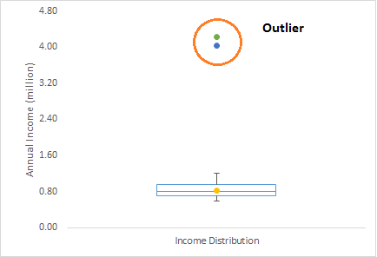
Techniques of Outlier Detection and Treatment
Outlier?
Outlier is a data point that differs significantly from other observations.
In below box plot there two customers annual income is much higher than rest of the population. These two observations will be seen as Outliers.

Slide 24
What causes Outliers?
Data Entry Errors:- Human errors such as errors caused during data collection, recording, or entry can cause outliers in data
Data Processing Error: Whenever we perform data mining, we extract data from multiple sources. It is possible that some manipulation or extraction errors may lead to outliers in the dataset.
Measurement Error: It is the most common source of outliers. This is caused when the measurement instrument used turns out to be faulty.
Sampling error: For instance, we have to measure the height of athletes. By mistake, we include a few basketball players in the sample. This inclusion is likely to cause outliers in the dataset.

Slide 25
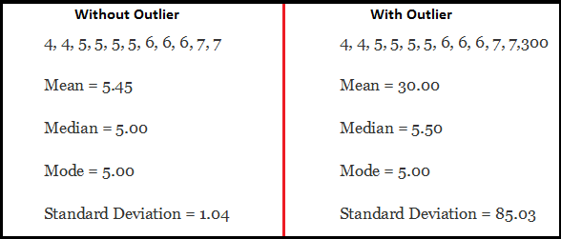
Impact of Outliers ?
Outliers increases the error variance and reduces the power of statistical tests
Outliers are non-randomly distributed, they can decrease normality
They can bias or influence estimates that may be of substantive interest
Outlier also impact the basic assumption of Regression, ANOVA and other statistical model assumptions.
let’s take an example to check what happens to a data set with and without outliers in the data set.

Slide 26
How to detect Outliers?
We can use various visualization methods, like Box-plot, Histogram, Scatter Plot. Some methods to detect outliers:
In Box-plot any value, which is beyond the range of (-1.5 x IQR to 1.5 x IQR) can be considered as Outlier.
Capping methods: Any value which out of range of 5th and 95th percentile can be considered as outlier
Data points, three or more standard deviation away from mean are considered outlier.
Indices such as Mahalanobis distance and Cook’s D are frequently used to detect outliers.

Slide 27
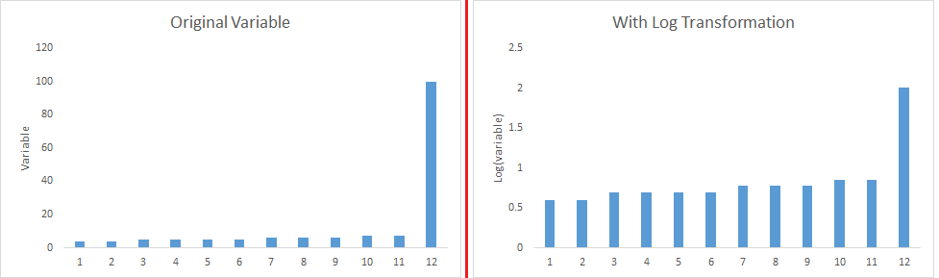
How to remove Outliers?
Deleting observations: We delete outlier values if it is due to data entry error, data processing error or outlier observations are very small in numbers. We can also use trimming at both ends to remove outliers.
Transforming values: Transforming variables can also eliminate outliers. Natural log of a value reduces the variation caused by extreme values.
Binning values: Binning is also a form of variable transformation. Decision Tree algorithm allows to deal with outliers well due to binning of variable. We can also use the process of assigning weights to different observations.

Slide 28
Imputing: We can also impute outliers. We can use mean, median, mode imputation methods.
Use statistical model to predict values of outlier observation and after that we can impute it with predicted values.
Treat separately: If there are significant number of outliers, we should treat them separately in the statistical model. One of the approach is to treat both groups as two different groups and build individual model for both groups and then combine the output.

Slide 29
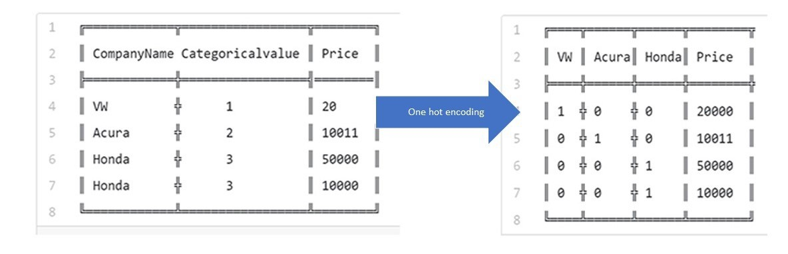
Categorical values into numerical values.
Two main methods are One-Hot-Encoding and Label-Encoder.
One-Hot-Encoding.
One hot encoding is a process by which categorical variables are converted into a form that could be provided to ML algorithms to do a better job in prediction.
Categorical variable binary representation is called one-hot, because each row has one feature with a value of 1, and the other features with value 0.
For example. Below table contains one categorical variable Company Name and applying one-hot-encoding we get this output.
One-hot encoding is done on mostly Nominal Data.

Slide 30
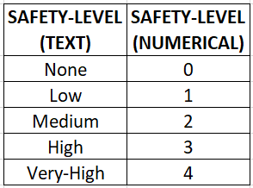
Label Encoding
LabelEncoder encode labels with a value between 0 and n-1 where n is the number of distinct labels.
If a label repeats it assigns the same value to as assigned earlier.
The categorical values have been converted into numeric values.
Label Encoding is done on mostly Ordinal Data.
For example, Below Safety-level column as Ordinal type data so we can apply Label Encoding.

Slide 31
Imbalance Data Set.
For Handling Imbalance Data Set we can apply these method - Undersampling, Oversampling.
Undersampling consists in sampling from the majority class in order to keep only a part of these points. Undersampling techniques remove examples from the training dataset that belong to the majority class in order to better balance the class distribution, such as reducing the skew from a 200:500 to a 200:200 class distribution.
Oversampling that involves adding examples to the minority class in an effort to reduce the skew in the class distribution. In this technique we add examples in the training dataset that belong to minority class in order to better balance the class distribution, for example converting 200:500 to a 500:500 class distribution by using SMOTE method.

Slide 32
Variable Transformation.
There are various methods used to transform variables. Some of them include square root, cube root, logarithmic, binning, reciprocal and many others. Let’s look at these methods in detail by highlighting the pros and cons of these transformation methods.
Logarithm: Log of a variable is a common transformation method used to change the shape of distribution of the variable on a distribution plot. It is generally used for reducing right skewness of variables. Though, It can’t be applied to zero or negative values as well.
Square / Cube root: The square and cube root of a variable has a sound effect on variable distribution. However, it is not as significant as logarithmic transformation. Cube root has its own advantage. It can be applied to negative values including zero. Square root can be applied to positive values including zero.
Binning: It is used to categorize variables. It is performed on original values, percentile or frequency. Decision of categorization technique is based on business understanding. For example, we can categorize income in three categories, namely: High, Average and Low. We can also perform co-variate binning which depends on the value of more than one variables.

